Slide 1
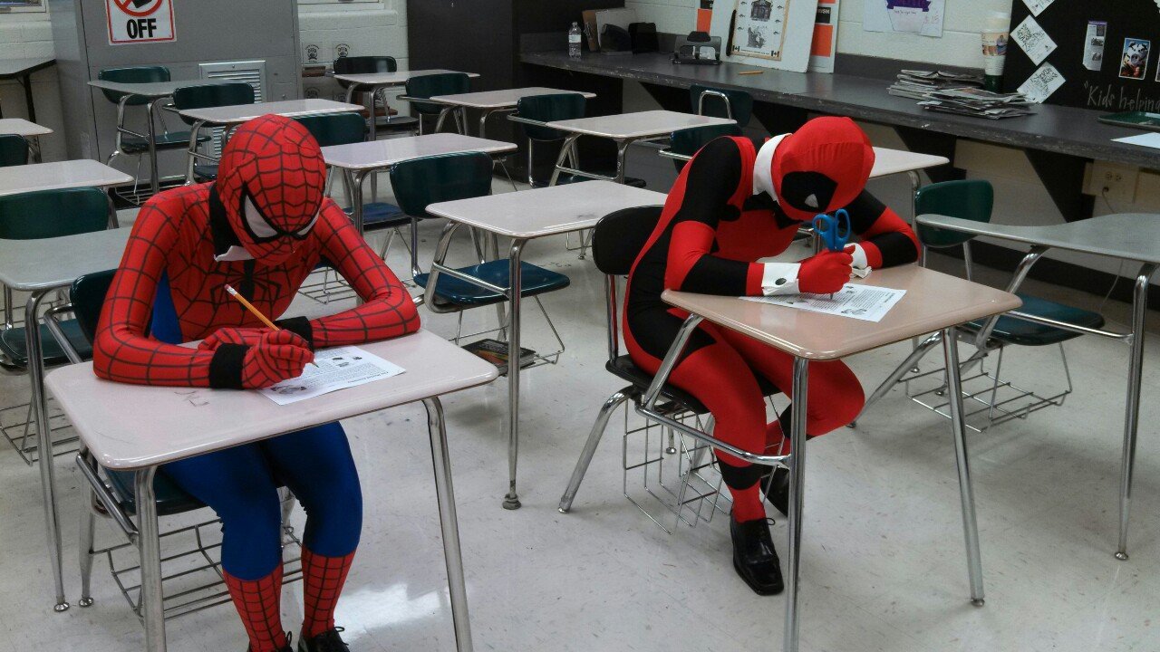
ENGL 108A:
Final Exam Structure

Slide 2
When and Where?
DATE: Friday July 28, 2017
TIME: 12:30pm-2:30pm
LOCATION: SJ1 3014

Slide 3
What is on the Final?
The final exam is cumulative
All units are included
All required texts on the syllabus are included
Includes everything on PowerPoint slides (all terms; concepts; contexts, etc. covered up to the last day of classes)
Anything from lectures is possible

Slide 4
Final Exam Structure
3 sections: you must complete all three sections (Parts I, II, and III)
Total of 50 marks
Read the questions carefully to know which texts / characters are options for you to write about

Slide 5
PART I: Definitions (10 marks)
In one or two sentences each, briefly define or explain FIVE of the following concepts, expressions, names, or terms, and demonstrate how it applies to one of the following texts:
You must use a different text for each definition (i.e., do not discuss a text more than once)
Each definition is worth 2 marks
Your answers must be written in complete, grammatical sentences; point form is not acceptable.

Slide 6
PART II: Visual Literacy (20 marks)
This part requires that you analyze the graphic image attached to the exam.
Write a close analysis no longer than three pages, double-spaced. Pay particular attention to the stylistic and technical devices and formal narrative strategies at work including, but not limited to, page layout, artistic style, text and image. More important than any of these three in isolation, however, is how they all work together to create meaning. Consider the themes, tropes, or motifs revealed by the panels and how the images on this introductory page establish and/or enhance the meaning and complexity of the story and its characters.

Slide 7
PART III: Short Answer (20 marks)
Choose TWO of the following topics / prompts, and write response that is approx. 1 page single spaced. Your analysis / response should draw upon any course readings, concepts, and arguments that are deemed relevant.
Provide examples and details to support your points.
This is not an essay and thus does not need to be formatted in essay structure.
You will have choice; each option will specify which text(s) to address
Each answer is worth 10 marks
Tip: Avoid plot description

